Slide 1
4COSCO11C.2 Web Design and Development
HTML Lists, CSS for Lists, HTML Tables , CSS for Tables, CSS Box Model
Week 2

Slide 2
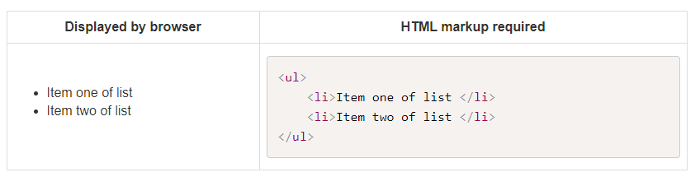
Lists
Unordered Lists
There are several types of list, an un-ordered list can be created by the following markup:

Slide 3
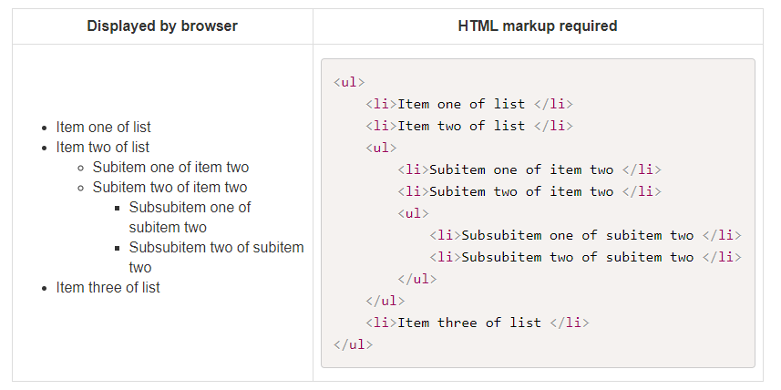
Nested Unordered Lists
Nested lists can be done as follows:

Slide 4
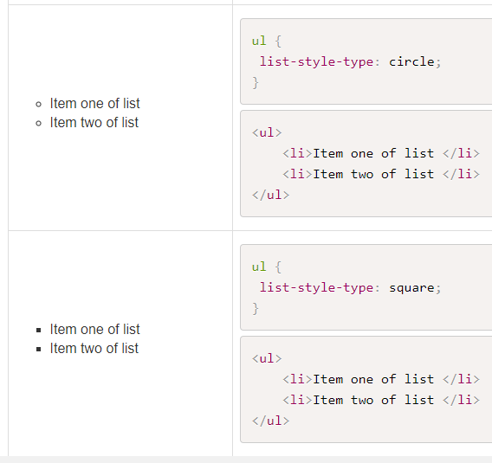
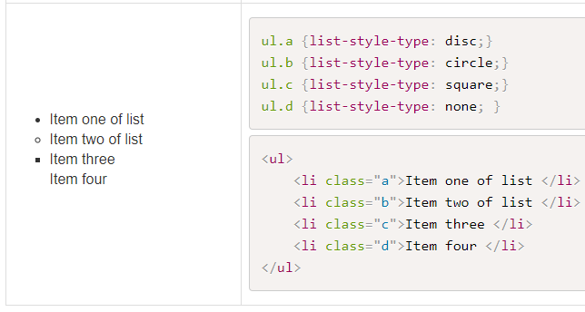
Changing the Appearance

Slide 5
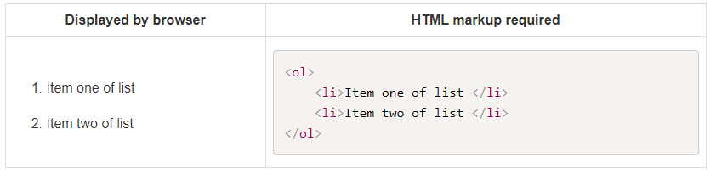
Ordered List
An ordered list is similar to an un-ordered list, except that each entry is consecutively numbered.

Slide 6
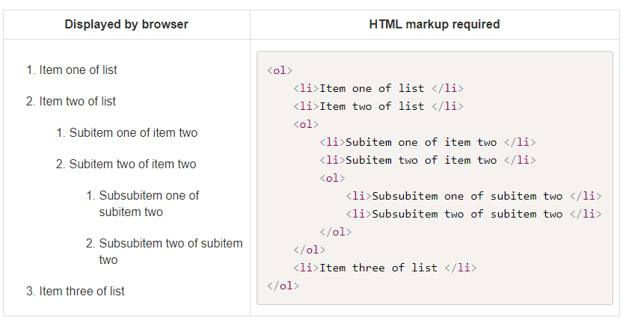
Nested Ordered Lists

Slide 7
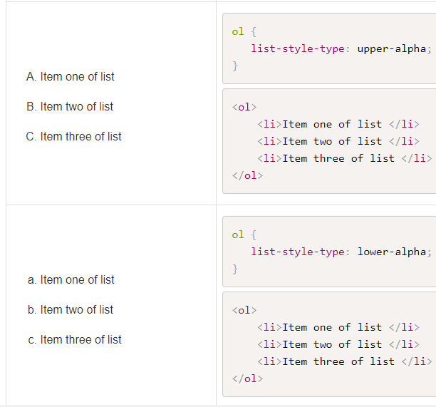
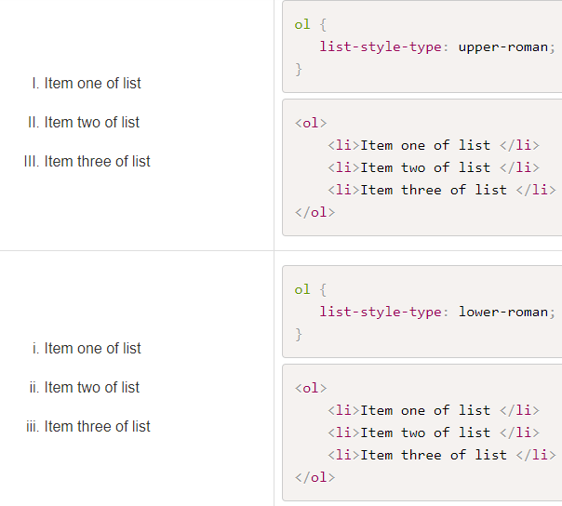
Changing the Appearance

Slide 8
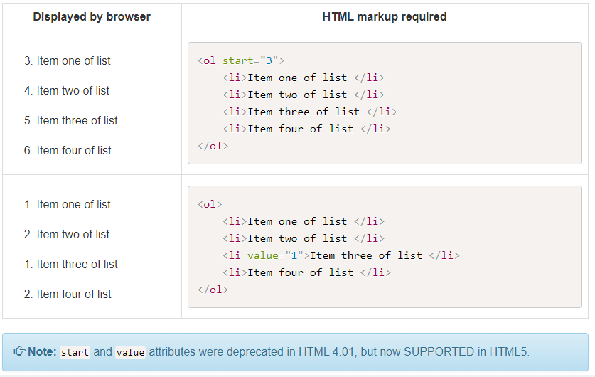
Contd….
It is possible to give a start value to the ordered list or to reset the counter:

Slide 9
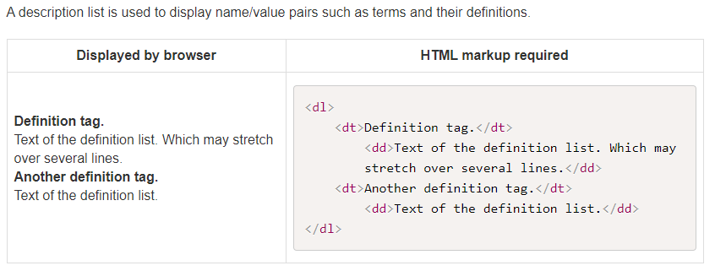
Description Lists

Slide 10
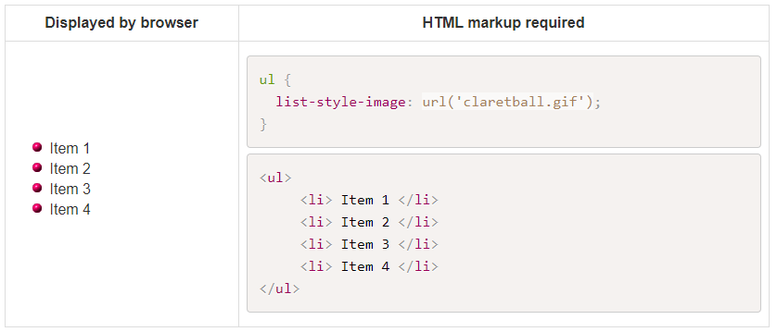
Lists with image bullets
It is possible to use your own graphics as bullets in an unordered list:

Slide 11
Review Questions
Question 1 - Which HTML tags are used to create an unordered list
Question 2 - Which HTML tags are used to create an ordered list
Question 3 - Write the HTML tags to display the following nested list (no CSS used):

Slide 12
Styling Lists
CSS can be applied to lists.
CSS unordered list styles: square, circle, disc (default), and none.
CSS ordered list styles: upper-alpha, lower-alpha, upper-roman, lower-roman, decimal (default), and none.

Slide 13
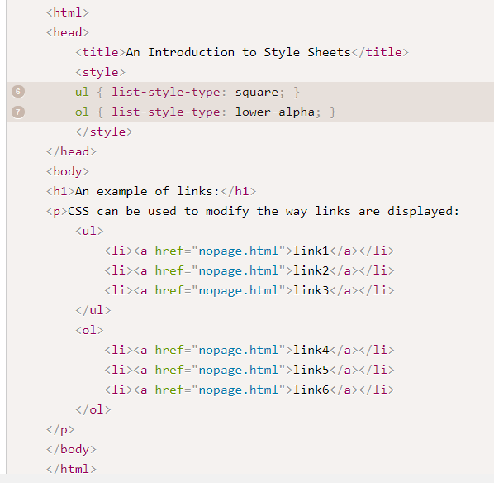
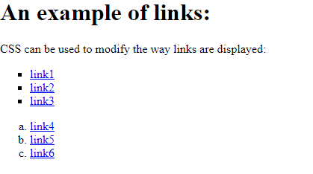
Styling Lists

Slide 14
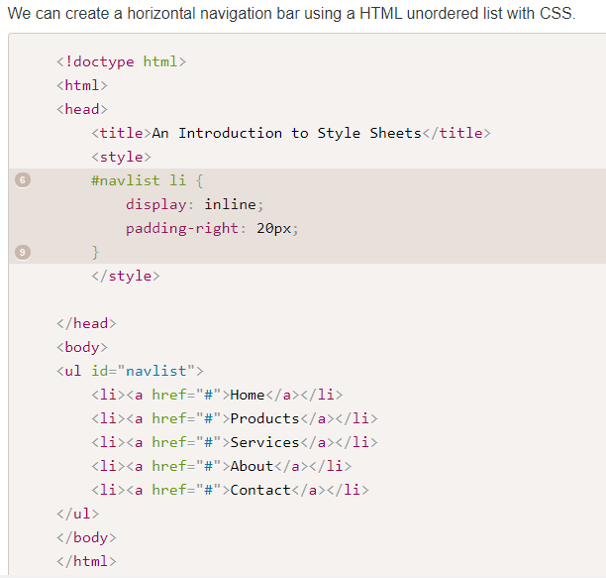


Lists as Navigation bars
We use "display:inline;" and use some padding to make some space between the list items. Padding is discussed in the next section.
Note that by default "display:inline;" removes the bullet points from the list. We could also do this by using:

Slide 15
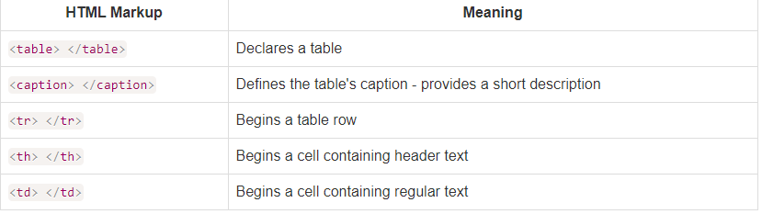
HTML Tables
The HTML tags to create a table are as follows:

Slide 16
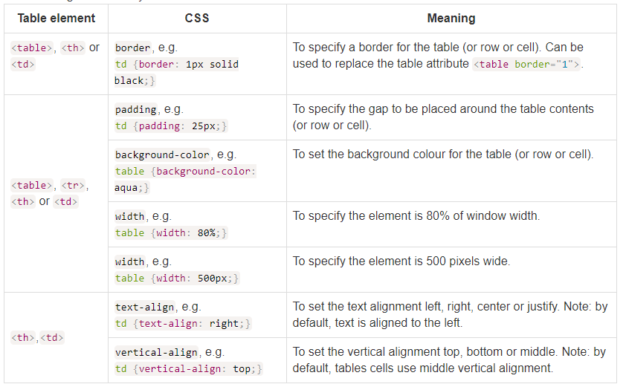
Table Attributes

Slide 17
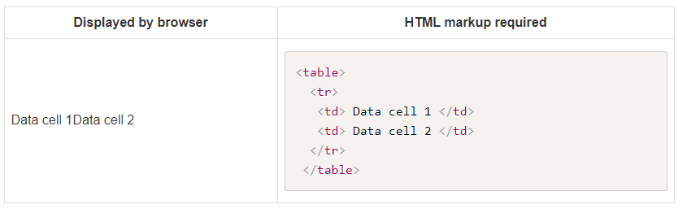
Row(s) of Cells
A Table in html is constructed horizontally, by creating rows of data cells as follows:

Slide 18
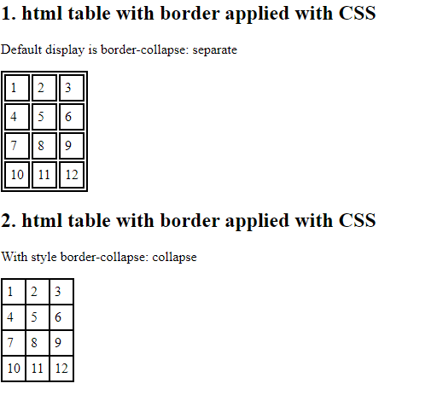
Table Borders
We can use CSS to add a table border and some padding as follows.
When we use CSS to add a border by default the table borders are separated border-collapse: separate;.
In the lecture examples, the default display is changed with border-collapse: collapse; so that the borders collapse into a single border.

Slide 19
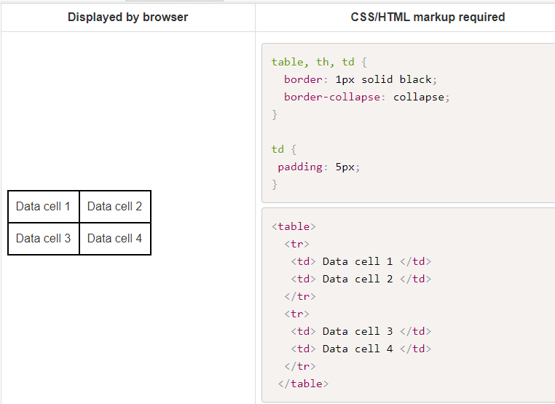
Adding more rows
You can add more rows to your table by adding a new <tr> tag followed by your table cells and content, and closing the row using the </tr> tag:

Slide 20
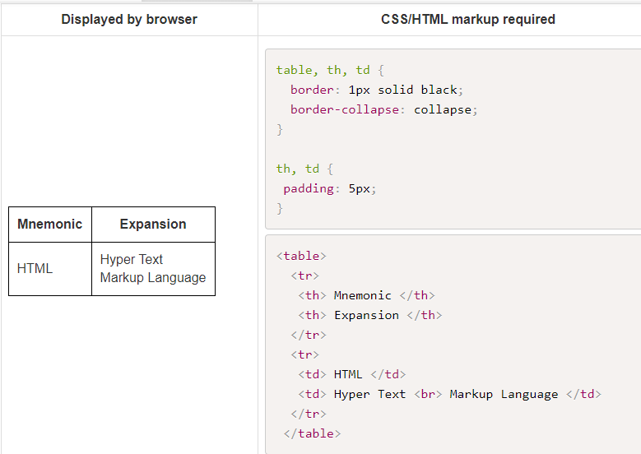
Heading to a Column
The tag <th> may be used instead of <td> if the cell is a header to a column of cells. For example:

Slide 21
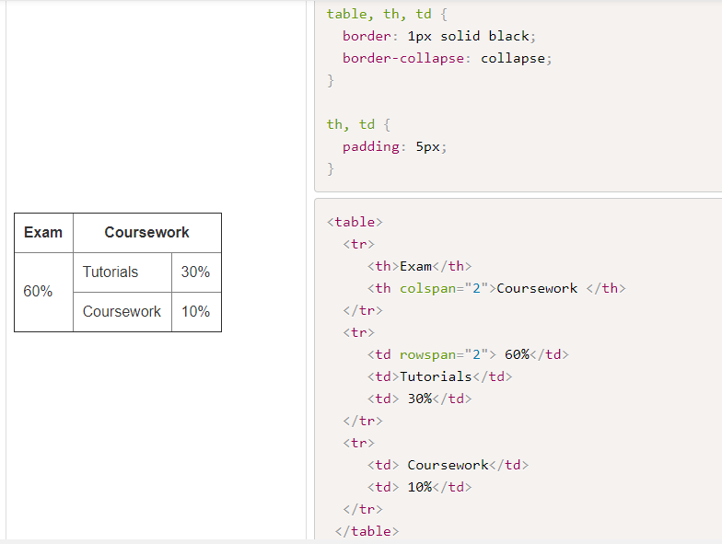
Spanning rows and columns
You can add the attributes rowspan and colspan to the HTML tags <td> and <th to form data cells which span more than one row or column. For example:

Slide 22
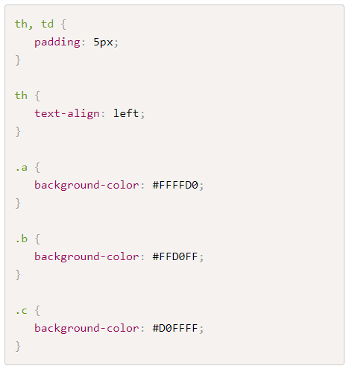
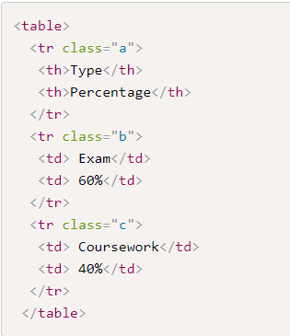
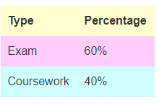
Coloring Table Cells
You can add the attributes rowspan and colspan to the HTML tags <td> and <th to form data cells which span more than one row or column. For example:

Slide 23
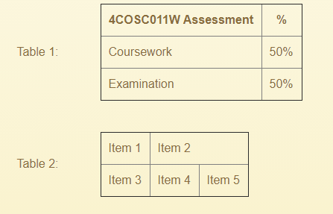
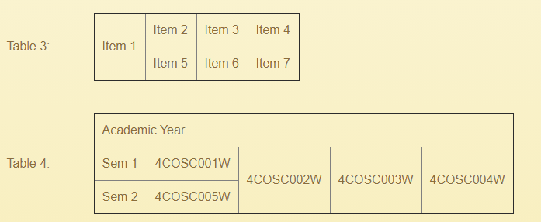
Review Questions
Question 1 - What is the difference between the <tr> and <td> tags
Question 2 - What is the difference between the <td> and <th> tags
Question 3 - Write the html tags to display the following tables (no CSS used):

Slide 24
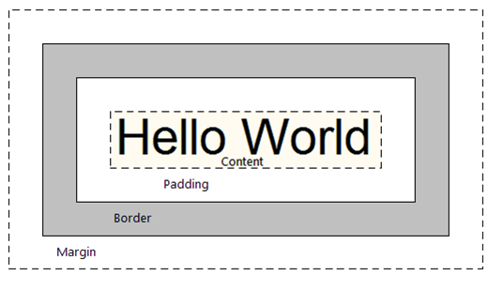
CSS Box Model
For CSS display purposes, every element in a document is considered to be a rectangular box.
The appearance and position of this box can be manipulated.
Each box has a content area (e.g., the text, image etc) and an OPTIONAL surrounding: padding, border and margin.

Slide 25
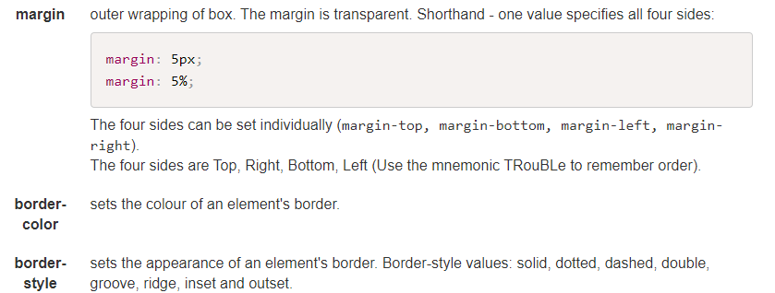
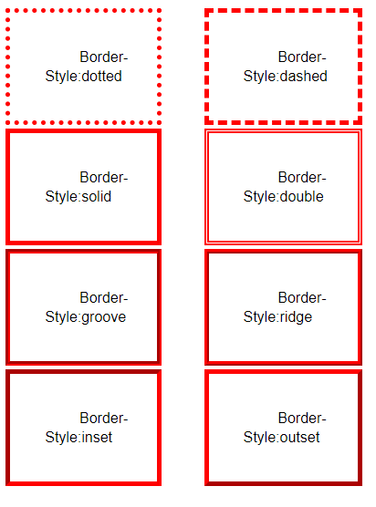
CSS Box Model Properties

Slide 26
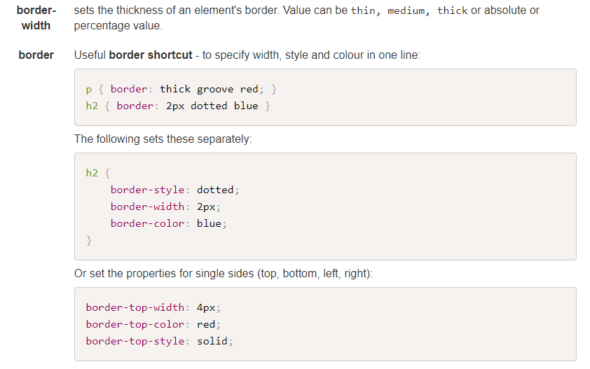
Contd

Slide 27
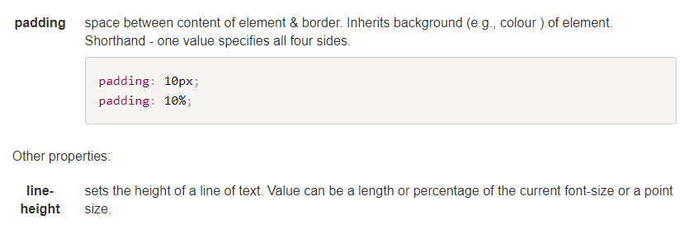
Contd

Slide 28

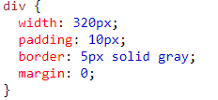
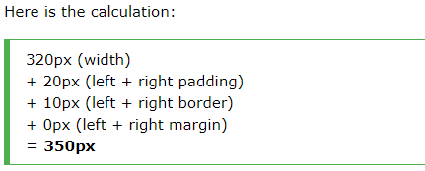

Calculating the total width/height of an element

